Slide 1
Human Anatomy Slideshow Created by Mr. Pfoutz All photo credits to Anatomy and Physiology Revealed

Slide 2
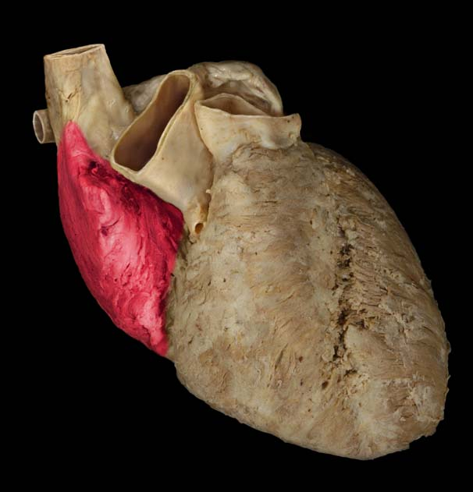
Notes:
So blood from the vena cava(e) fills the right atrium. The right atrium contracts and pushes blood through a valve and into the right ventricle.

Slide 3
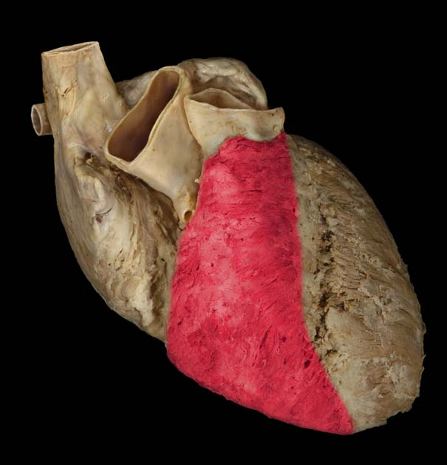
Notes:
So the valves shut and the blood is in the right ventricle. The ventricles are more muscular than the atria…can anyone guess why? Because they have to push blood out of the heart and into the body.

Slide 4
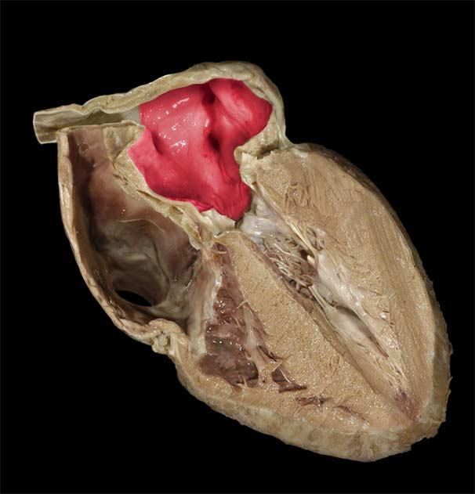
Notes:
Left atrium from the inside.

Slide 5
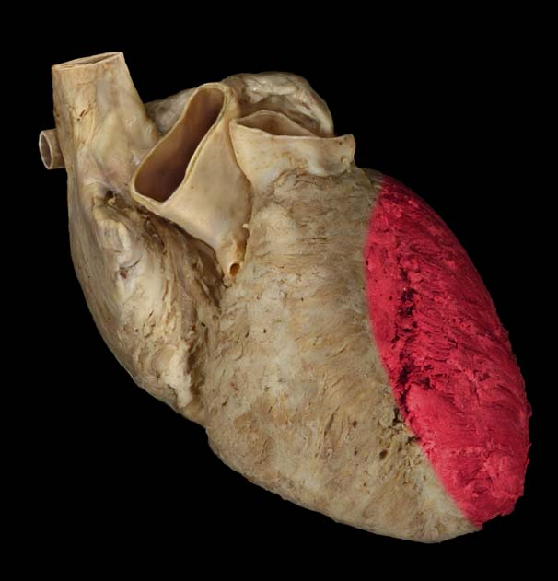
Notes:
Left ventricle. The strongest/most muscular chamber of the heart. Why?

Slide 6
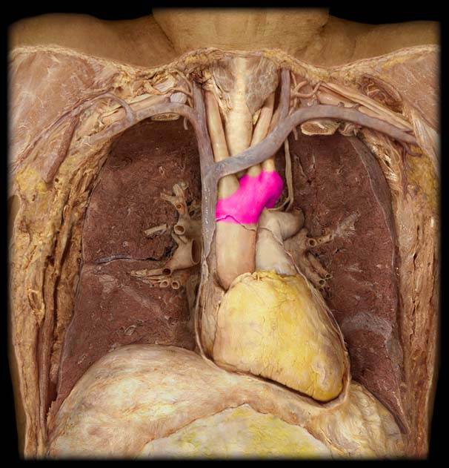
Notes:
Aortic Arch or Arch of the Aorta. Three major arteries branch off of this segment to go to the neck/head and shoulders/arms.

Slide 7
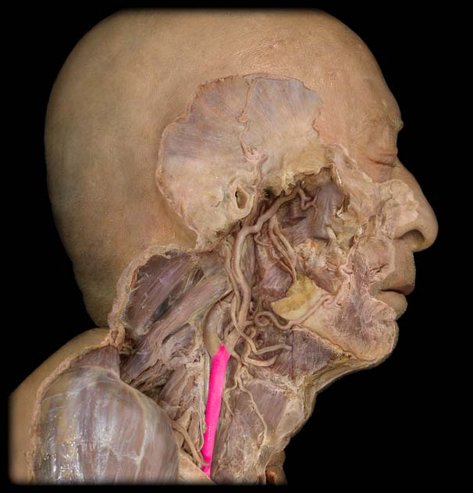
Notes:
The common carotid artery is one of those that branches off of the aortic arch. It goes into the head. This is the artery from which you take your pulse.
Why might we take our pulse here rather than in another artery?

Slide 8
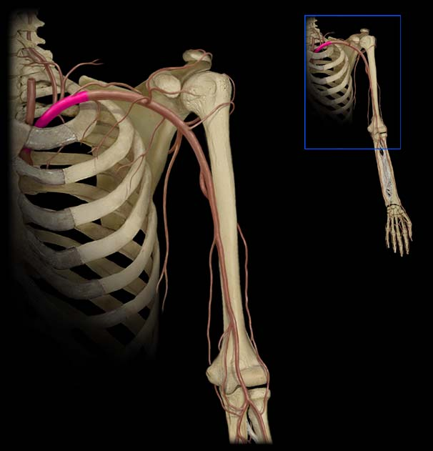
Notes:
A third angle here. In this angle is it very easy to see the clavicle and how the vessel travels underneath it.

Slide 9
Notes:
Brachial Artery. The major vessel travelling down the upper arm.
We use this vessel for an important medical/health test…what is the test?

Slide 10
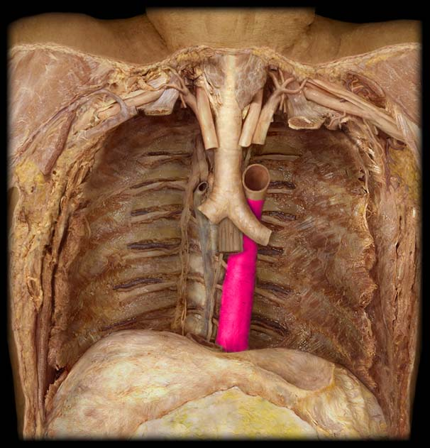
Notes:
Back to the center of the body we start to head towards the feet. This is the descending aorta, a huge and important vessel that carries blood to everything below the heart. This is in the chest cavity or the thorax so this specific part of the descending aorta is called the ‘thoracic’ aorta.

Slide 11
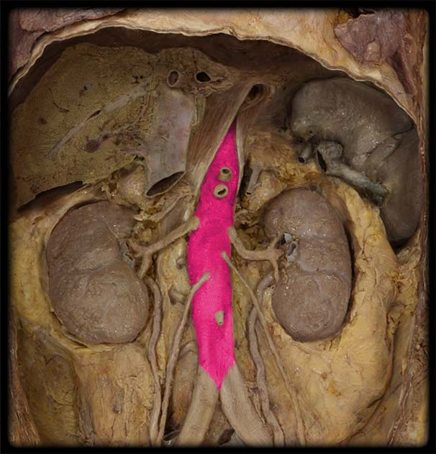
Notes:
This is the abdominal aorta. Part of the descending aorta. We are now in the abdominal cavity.
What are some other organs that you see surrounding the abdominal aorta? Spleen, liver, kidneys, adrenal glands (suprarenal glands)

Slide 12
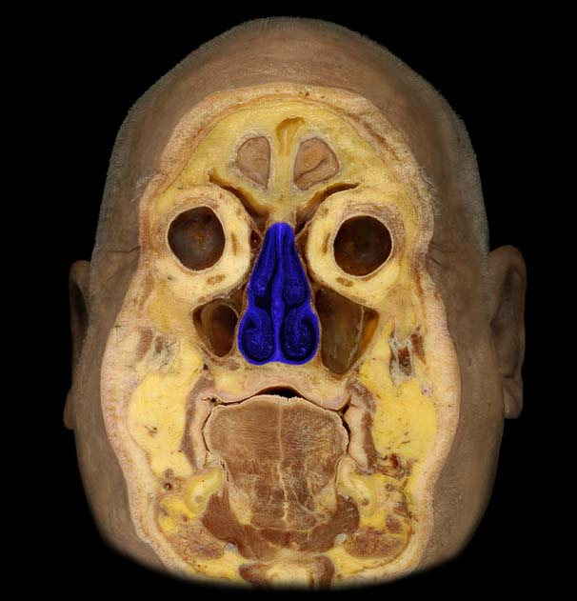
Notes:
Nasal Cavity. The nasal cavity is made up of several ‘swirled’ structures that are covered in a mucus layer.
Why is it important for these structures to be covered in a mucus layer?
The air we breathe will sort of swirl around these passage ways and debris will stick to the mucus layer and will ultimately be either blown/spit out or it will be swallowed. Stomach acid will take care of much of the intruders…if they all made it into the respiratory system they could be more of a problem.
The nasal septum is the structure that divides the two sides of the nasal passage way. In some people this is a bit off-center so it makes it more difficult to breath through one side of the nose.

Slide 13
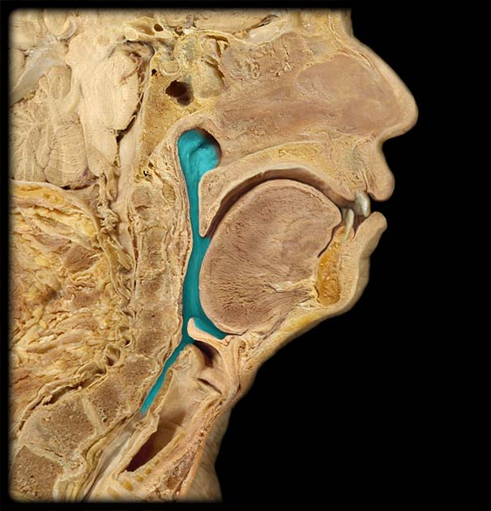
Notes:
This is the pharynx. The first major section of the respiratory system. It is made up of three parts which we will get to in a second.

Slide 14
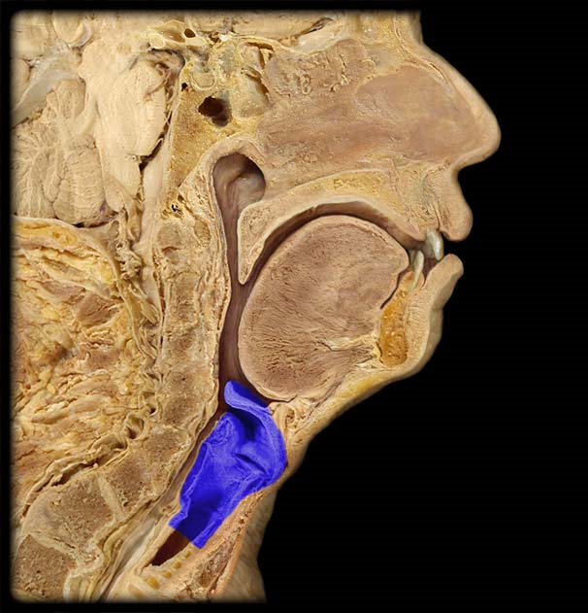
Notes:
Larynx. This is the second major portion of your respiratory system. It is also called your ‘voicebox.’

Slide 15
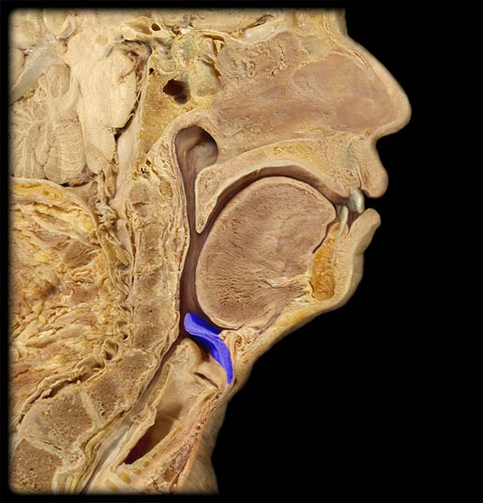
Notes:
Epiglottis. This little flap is incredibly important. When you swallow the flap closes down over top of your larynx to prevent food or drink from entering the larynx.

Slide 16
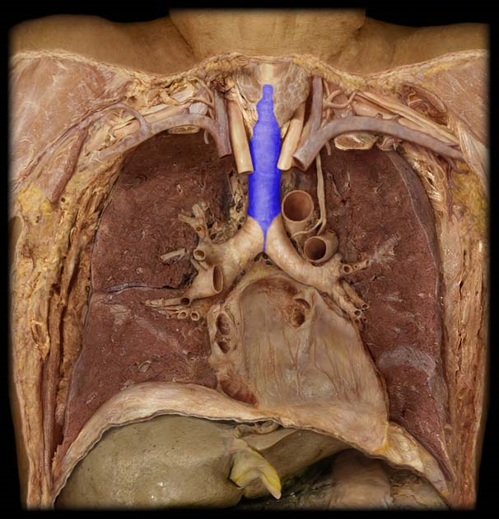
Notes:
Trachea 2.

Slide 17
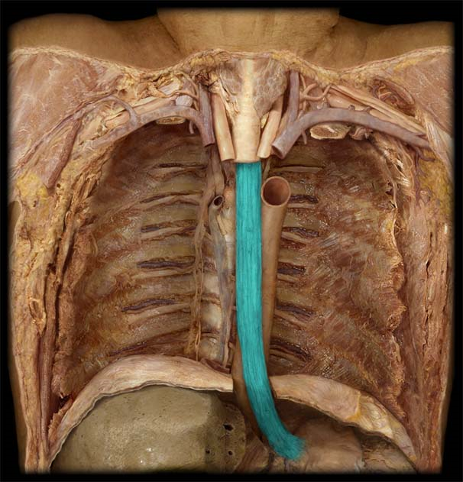
Notes:
Esophagus

Slide 18
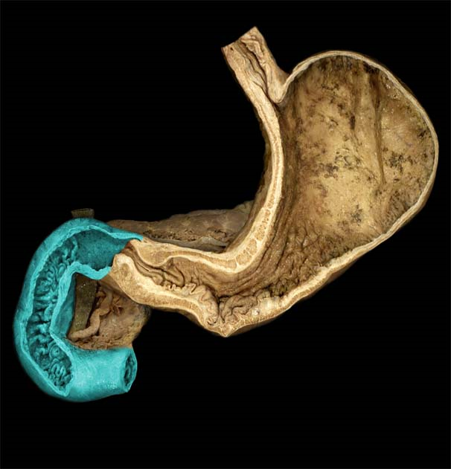
Notes:
Duodenum. This is the first part of the small intestines. The function of the small intestines is to absorb nutrients.

Slide 19
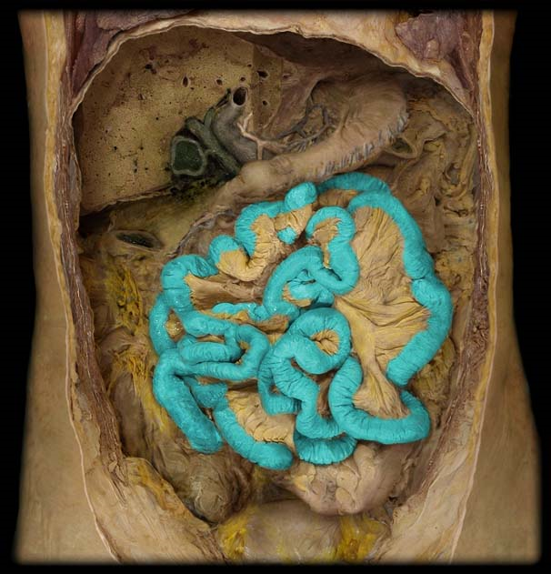
Notes:
Small intestines. The purpose once again is for nutrient absorption. We already learned the first section which is called the duodenum. The upper section is called the jejunum and the lower section is called the illeum.

