Slide 1
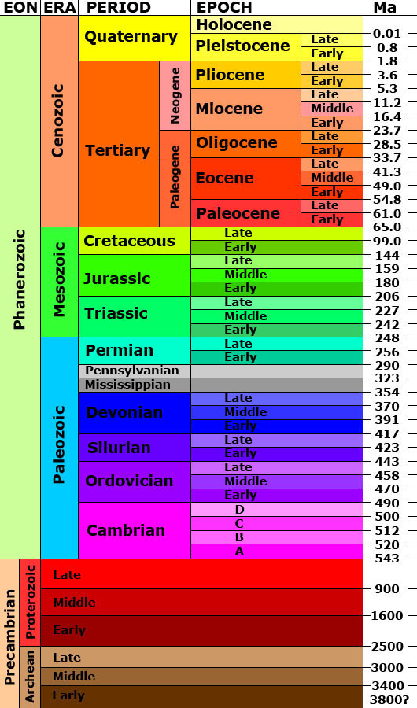
Instructions: Use the geologic timeline below and the interactive timeline found at http://www.pbs.org/wgbh/evolution/change/deeptime/index.html
to add at least 10 important events throughout the history of life. Give the event and a brief description.
http://www.pbs.org/wgbh/evolution/change/deeptime/index.html
Name:
Land Plants: Green algae washes ashore and is able to adapt to live on land.

