Slide 1
Build-A-Dragon Project

Slide 2
To Print Your Dragon:
Make sure your names are on your final document and that your table and dragon are complete.
Click the Microsoft office button in the top left → Click Print → Select the “LEXMARK” printer
Under the Print Range heading click “slides” → Enter the slide number for your completed dragon and table (it should be slide “3”).
Select OK and retrieve your work from the printer.
TIP:
If an elements overlaps, make the background transparent by clicking on ‘Format’ then ‘Recolor Picture’, then ‘Set Transparent Color’. Then click on the background of the image you are moving around.
Directions
On the next slide, put you and your partner’s name in the top box.
With your mate, complete the table on the next slide with your dragon’s genotypes (genotypes are generated from the excel file on my website). Use the generator once for the maternal allele, then a second time for the paternal allele.
Using the table at right, complete the phenotype column on the next slide.
Start building your dragon by copying the elements from the following slides, then paste them on top of the grey template.
Do the body first, then the tail and forelimb (if present). They should all be the same color.
If tail spikes are present, add them in the appropriate color.
Add the correct size and color wings.
If the horn is present, add it.
If the dragon can breathe fire, add fire!
Add the appropriate eyes based on color and shape.
If body spots are present, add some by inserting some black circles on the body. (Insert → Shapes)
Make sure your names are in the top box, and give your completed dragon a name.
When finished, save the ppt to your computer, then print ONLY THE ONE FINISHED SLIDE!!
Trait | Dominant | Recessive
Body Color | Green | Blue
Forelimb | Present | Absent
Tail type | Long | Short, flat
Tail Spikes | Absent | Present
Wing Size | Large | Small
Wing Color | Grey | White
Horn | Present | Absent
Fire Breathing | Non-fire breather | Breathes fire
Eye Color | Red | Yellow
Eye Style | Diamond | Round
Body Spots | Absent | Present

Slide 3
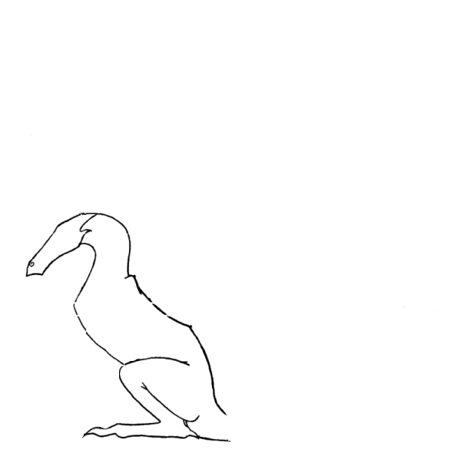
Trait | Maternal Allele | Paternal Allele | Phenotype
Body Color | G
Forelimb | A
Tail type | L
Tail Spikes | S
Wing Size | T
Wing Color | W
Horn | H
Fire Breathing | F
Eye Color | R
Eye Style | D
Sex | X
Body Spots | P
Designers:
Dragon’s Name:

Slide 4
Bodies

Slide 5
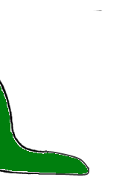
Short, flat tail
Forelimb
Long tail

Slide 6
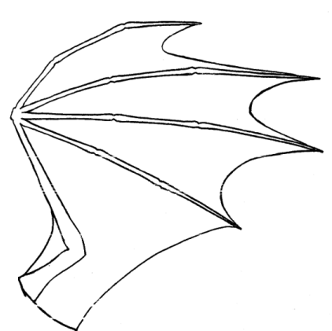
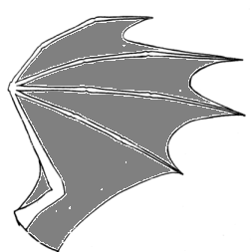
Wings

Slide 7
Tail Spikes
Horns
Eyes
Fire Breath

