Slide 1
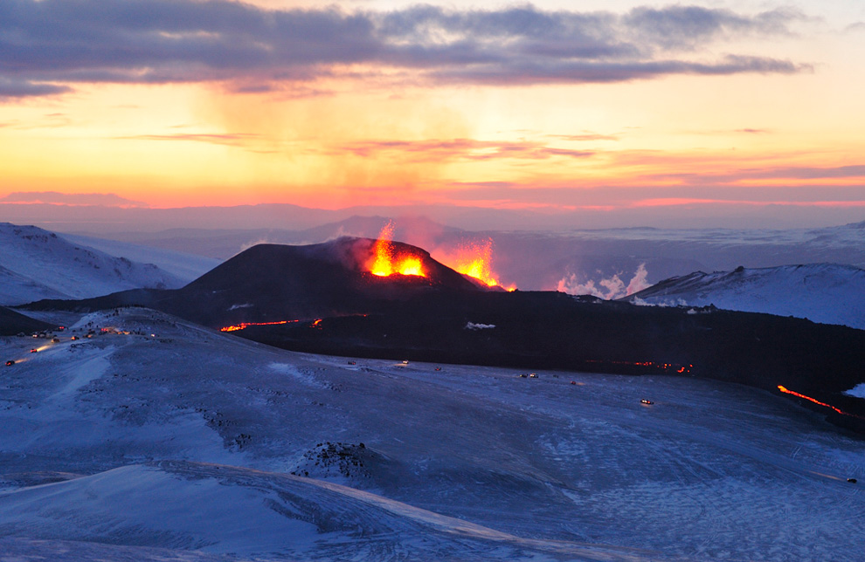
Name of Volcano
Student Name
Type of volcano
Location of Volcano:
City, State, Country
Picture of volcano:
5 Interesting Facts:
-
-
-
-
-
Volcano Elevation

