Slide 1
BIOME SAFARI: Enter your biome here
By: Enter your name(s) here
Feel free to change any fonts, background colors, etc. to your liking.

Slide 2
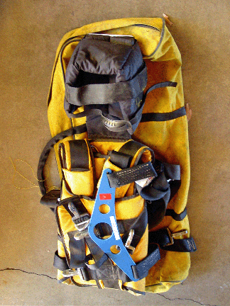
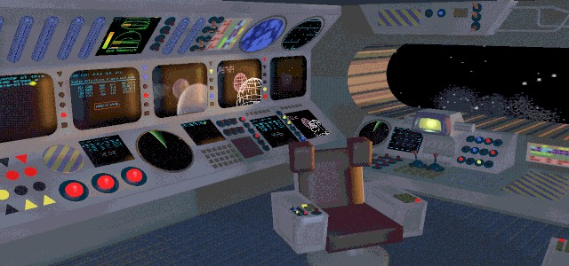
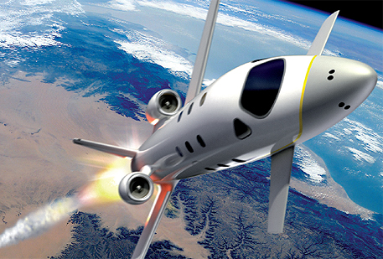
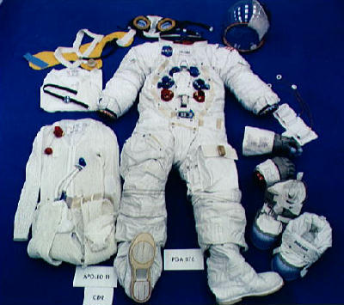
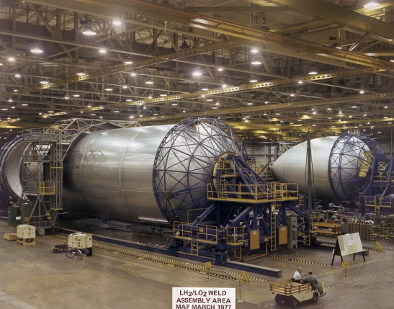
Example Slide: Proper Equipment and Dress. Delete this slide before presenting. Each slide should have at least 3 images and at least 3 sentences of script in the notes section below.
Control Room
Spaceship
Space pack
Oxygen tank for ship
Space suit
Notes:
We will travel to our space biome in our state of the art spaceship which is run by a high-tech control room. Oxygen for the ship will be provided by the enormous tank seen at the bottom left. We will wear space suits to protect us from the dangers of space and to provide us with oxygen. We will also need space packs seen at the top left to carry our extra gear.

Slide 3
Location
You should fill this space with images that show where your biome is located in comparison to the equator.
Notes:
Insert your 3 sentence script here.

Slide 4
Physical Characteristics
Fill this space with images of the physical characteristics of your biome like climate and land features (mountains, streams, hills, etc…).
Notes:
Insert your 3 sentence script here.

Slide 5
Proper Equipment and Dress
Fill this space with images of equipment you will need, proper gear and clothing, and your vehicle of choice for the safari.
Keep in mind that the vehicle selection should reflect the physical characteristics of the biome! You can be creative here! Pick any appropriate form of transportation! A plane, train, moped, hover craft, submarine, or walk on foot. But make sure it is appropriate for your biome!
(You wouldn’t take a helicopter across the rainforest because the tree canopy would block your views…just like you wouldn’t take a Kia through the tundra).
Notes:
Insert your 3 sentence script here.

Slide 6
Plant Life and Adaptations
Fill this space with images of at least 3 types of plant life that you’ve found on your safari. Include their specific adaptations that help them be successful in your biome.
Notes:
Insert your 3 sentence script here.

Slide 7
Animal Life and Adaptations
Fill this space with images of at least 3 types animal life that you’ve found on your safari. Include their specific adaptations that help them be successful in your biome.
Notes:
Insert your 3 sentence script here.

Slide 8
Natural Resources
Fill this space with images of at least 3 types of natural resources you have discovered on your safari. Include how these resources can benefit humans.
Notes:
Insert your 3 sentence script here.

Slide 9
Human Impacts
Fill this space with images of evidence of human impacts that you have found on your safari.
Notes:
Insert your 3 sentence script here.

Slide 10
Conclusion
Use this space to briefly conclude your journey or add any additional images/information that didn’t fit with the other slides.
Notes:
Insert your 3 sentence script here.

